Slide 1

CUSTOMER SEGMENTAION
By: Rahul Singh kshatriya

Slide 2
INTRODUCTION
Customer segmentation is done to divide customer into different groups having similar characteristics
By doing so we can identify most and least profitable customers
Build loyal relationships with customers
Maximize the use of resources
Improve products to meet customer requirements

Slide 3
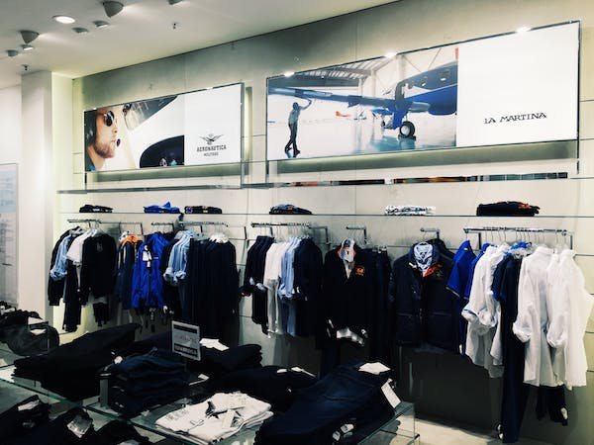
OBJECTIVES
To divide customers into different groups based on their annual income, spending score, age group they belong to, and spending behavior.
So that we customize marketing strategies uniquely for different segments which will increase effectiveness of marketing
And to offer services and products based on their segment characteristics

Slide 4
METHODOLOGY
Data we will be working on is of mall customers
First we will be doing some descriptive and exploratory data analysis using python to get a better understanding of data
Segmentation of customers will be done using K means clustering algorithm which is an unsupervised machine learning technique in python using scikit – learn machine learning package

Slide 5
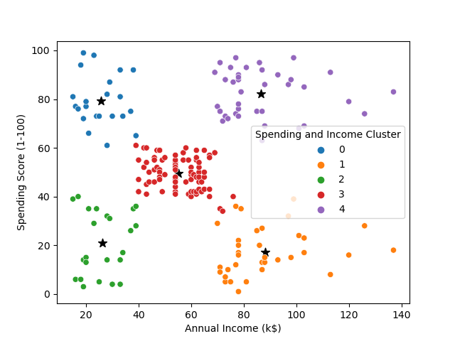
POTENTIAL SEGMENTS
We can divide our customers into 5 segments
Cluster 0: Low annual income & high spending score
Cluster 1: High annual Income & low spending score
Cluster 2: Low annual income & low spending score
Cluster 3: Moderate annual income & moderate spending score
Cluster 4: High annual income & high spending score

Slide 6
CUSTOMER SEGMENT 0
Customers of this segment have low annual income and high spending scores
Formed by 60% female and 40% male
Average age of 25 years
We will call this segment as the big hearted group

Slide 7
CUSTOMER SEGMENT 1
Customers of this segment have high annual income and low spending scores
Formed by 46% female and 54% male
Average age of 41 years
We will call this segment as the savers

Slide 8
CUSTOMER SEGMENT 2
Customers of this segment have low annual income and low spending scores
Formed by 60% female and 40% male
Average age of 45 years
We will call this segment as the cheapskates

Slide 9
CUSTOMER SEGMENT 3
Customers of this segment have moderate annual income and moderate spending scores
Formed by 60% female and 40% male
Average age of 42 years
We will call this segment as the mediocre’s

Slide 10
CUSTOMER SEGMENT 4
Customers of this segment have high annual income and high spending scores
Formed by 53% female and 47% male
Average age of 32 years
We will call this segment as the affluent group

Slide 11
THANK YOU
“Torture the data, and it will confess to anything.”
— Ronald Coase

